Slide 1
Variables, Expressions and Operators.
Week 1 | Lecture 2 (1.2)
Notes:
If you’ve got some time now, go to quercus, lecture outline, scroll to Week 1, and click Kinsella and Goodfellow. Click notebook for Lecture 1.2

Slide 2
This Week’s Content
Lecture 1.1
Introduction
Lecture 1.2
Variables, Expressions, and Operators
Chapters 1,2, and 3
Lecture 1.3
The Programming Process

Slide 3
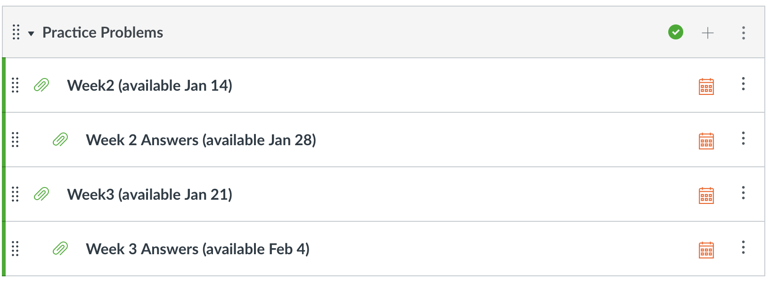
Reminder for Success: Practice!
Programming is a language
Everything is cumulative
Practice Problems released weekly, with solutions released 2 weeks later
Use labs and practice problem sets as litmus tests
Do them all, take note of which questions give you trouble

Slide 4
Recap: What is Programming?
A way of telling a computer what to do.
A computer can’t infer (…yet).
Need to tell a computer every single step it needs to do in a language it can understand.
How would you request an egg for breakfast to a chef and to a computer/robot?
To a Chef
Sunny-side up, please!
To a Computer
“Turn on stove”
“Take out pan”
“Take one egg out of fridge”
“Crack egg”
“Pour egg into pan”
“Wait 5 minutes”

Slide 5


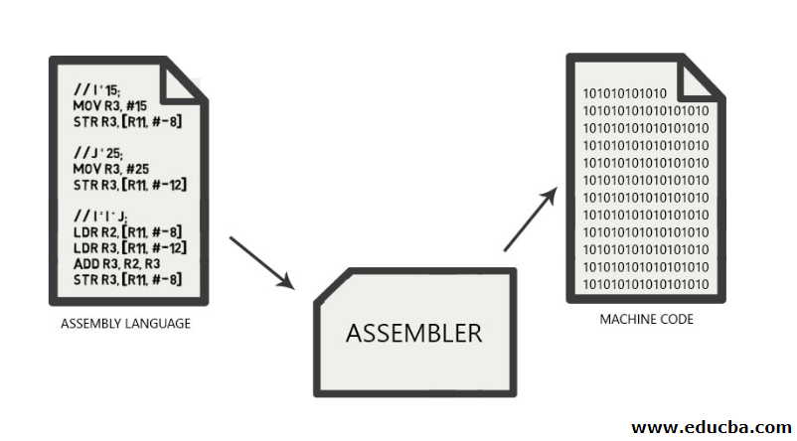
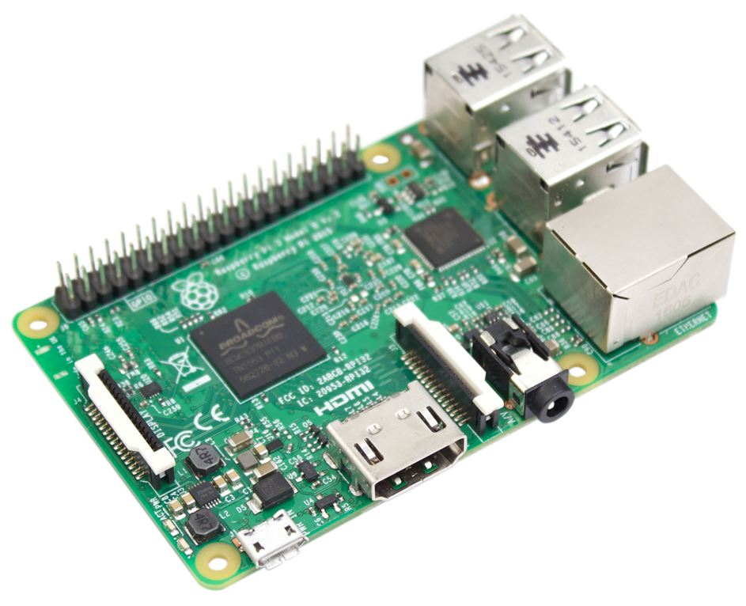
Programmer
How to Program a Computer.
English
Pseudocode
if x > 10:
print(“x is greater than 10”)
Programing Language
Compiler
Assembly Code
Assembler
Machine Code
Hardware
Notes:
Quick

Slide 6
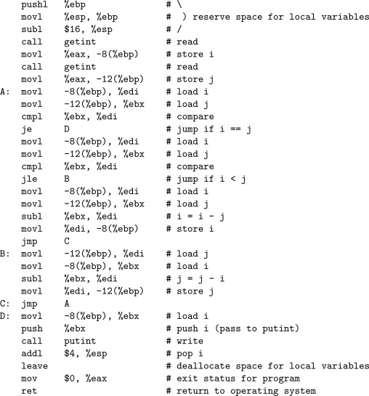
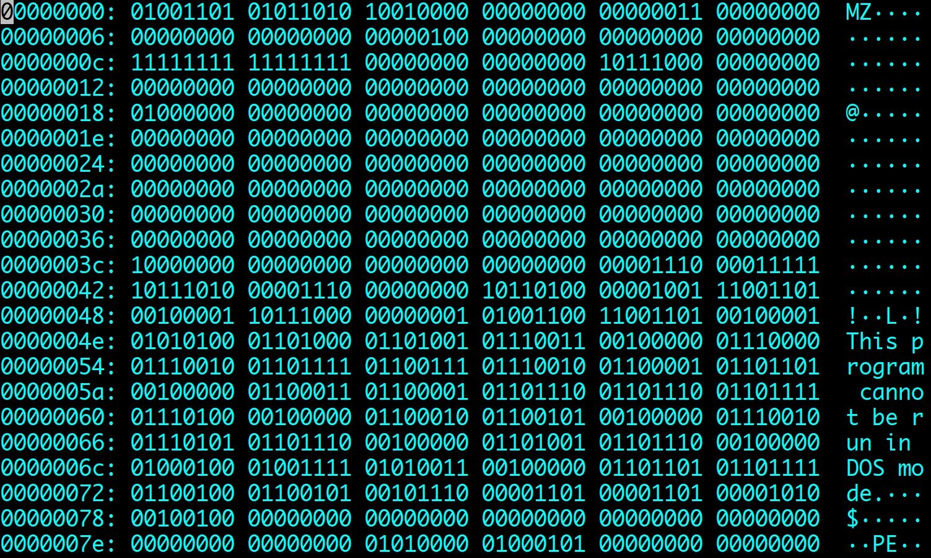
The power of programming languages
if x > 10:
print(”x is greater than 10”)
Notes:
Assembly code on the left, you definitely don’t need to know what that does, but you can see based on the comments on the right, that there’s only 1 very simple step per line. Whether that’s read, store I, read, store J, load I, load J, compare, all of these steps could have been done in a line or two of python code. And then you’ll see how it converts to machine code. The most basic form of code that the hardware on your computer is using, just 0s and 1s. You don’t necessarily need to know this, but does anyone know what the 0s and 1s represent?
Basic code for off and on, switches in the electrical hardware, turning on and off, depending on the 0 or 1, that creates the electrical signal to produce the output you want. But this may as well look like the matrix code for a lot of us. This is why we use a programming language like Python. We can take something in code we can easily write and understand, and turn that into a series of electrical signals that our computer produces to create an output we want.

Slide 7
Introducing Python
No end-of-instruction separators, such as semicolons (like in C or Java)
Programs are stored in .py files
Comments start with a # character
Whitespace matters (exactly 4 spaces means indentation)
Python is an interpreted language (not a compiled one)
You can run code one statement at a time, just like a calculator or Matlab
This means variables can change type during runtime, and do not have to be declared before running
Notes:
Exciting slide, I know. But this is a good reference slide for you to come back to for the basics – it’s also super important info for anyone with programming experience in another language. READ SLIDE
I’ve been teaching programming for almost 10 years, and one of the most frustrating things to see is students who don’t study and don’t pay attention in this course because they are already super competent programmers in Java, or C, or anything other than Python. Then they show up to the midterm, and start putting semi-colons after each line, using the wrong character for commenting, and then they fail! Even as very competent and experienced programmers. So if you’re an experienced programmer, take note of these previous students’ mistakes. And if you’ve never programmed at all before, know that you’re not at as much of a disadvantage you might think. You get a fresh start, in the language we’re going to be evaluating you in, and won’t be misled by previous knowledge.

Slide 8
Arithmetic Operators
Operator
Operation
Expression
English description
Result
+ | addition | 11 | + | 56 | 11 plus 56 | 67
- | subtraction | 23 | - | 52 | 23 minus 52 | -29
* | multiplication | 4 | * 5 |  | 4 multiplied by 5 | 20
** | exponentiation | 2 | ** | 5 | 2 to the power of 5 | 32
/ | division | 9 | / 2 |  | 9 divided by 2 | 4.5
// | integer division | 9 | // | 2 | 9 divided by 2 | 4
% | modulo (remainder) | 9 | % 2 |  | 9 mod 2 | 1
Notes:
Let’s start with one of the most basic uses of Python, or many programming languages, which is arithmetic! Or using it as a form of calculator.
The first three of these should look pretty common sense. Maybe only the * looks off in multiplication, but the * is pretty common for multiplication in all programming languages.
We have a ** for exponentiation
And Then 2 types of divison, that’s a bit weird. One is the division you’re used to. And if you see // that’s integer division. What that means is it takes does the division, and then cuts off the parts after the the decimal place. It does NOT round. Notice the answer here says 4, not 5.
Finally probably a new operator for most of you – the modulus operator, that looks like the percent sign, outputs the remainder of the division. We’ll see some examples of this in Jupyter in a few seconds.

Slide 9
Arithmetic Operator Precedence
When multiple operators are combined in a single expression, the operations are evaluated in order of precedence (from left to right)
Operator
Precedence
**
highest
- (negation)
*, /, //, %
+ (addition), - (subtraction)
lowest
Notes:
Order of operations! I always called this BEDMAS, schools might call it another acronym.
So the first thing would be the exponents, then basically all the multiplication and division operators in order from left to right, ending with addition and subtraction.
There’s one thing missing from this slide that’s not really an operator but certainly affects order of operations, what is that? CHAT Brackets, or parenthesis, which of course takes the highest precedence.

Slide 10
Using Python as a Calculator
Let’s start with a simple use of Python to get the feel for our new environment
Don’t forget your BEDMAS (or PEMDAS)!
Lecture Outline -> scroll down to Week 1, Kinsella & Goodfellow Link -> Lecture 1.2 “Notebook” link
This will open up Jupyter Notebook with today’s lecture code
Jupyter Hub: jupyter.utoronto.ca
Requires no installation, not even Python!
Open your notebook
Click Link:
1. Using Python as a Calculator
Notes:
Our first breakout coding session that we’ll do together. We’re going to do this a few times today, so keep the notebook open, and get used to this, because we’re going to do it a lot this semester. We were hoping to do this in person, and walk around and let you code and we’d help in lecture, but for now it will be slightly more guided, so I can show you what Python coding looks like.

Slide 11
Variables and Memory
The most basic thing you can do in a computer program is to assign a value to a variable.
Assignment statements
x = 20
(or)
y = 20+5*2
Rules for assignment
1. Evaluate the expression to the right of = sign (produces memory address of the value)
2. Store the memory address in the variable on the left of the = sign
variable = expression
Notes:
Get used to this formula –> variable = expression
Variable is something like x, or cat, or any name you decide to come up with, and the expression, just like a math expression, it something Python will evaluate and assign to the variable. That can be a single number, a previously stored variable name, or a math expression Python will work out for you.
This is NOT checking if they are equal, this is not doing some mathematical balancing to evaluate for x or make them equal, the = sign in Python (and most other programming languages) assigns what is on the right, to the variable name on the left. This variable name can then be called and accessed with it’s name at any point throughout the program, unless it’s changed.

Slide 12
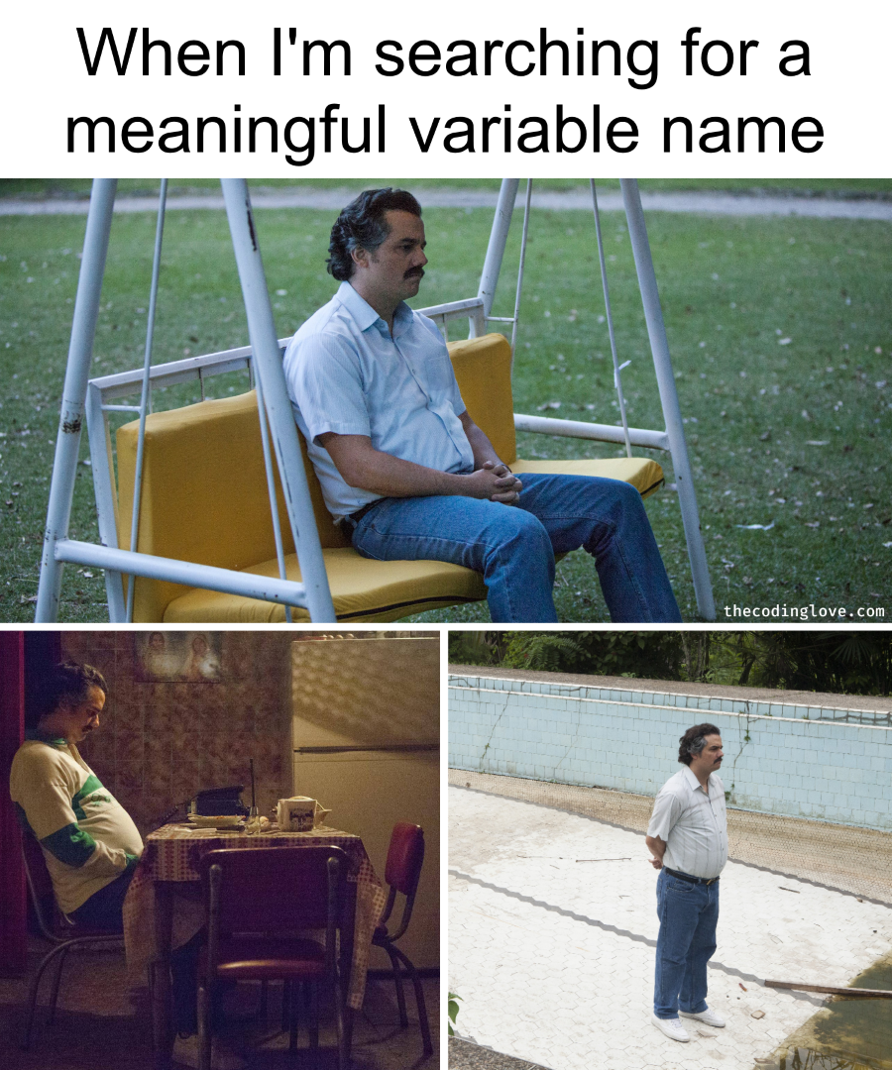
Variable Names and Conventions
The rules for legal Python names:
Names must start with a letter or _ (underscore)
Names must contain only letters, digits, and _
In most situations, the convention is to use pothole_case
Lowercase letters with words separated by _ to improve readability
Try to add meaning where possible!
Ex: gas_mileage and cost_per_litre instead of nomnom and nomnomnom
Save yourself when debugging & put your TAs in a good mood when marking
Notes:
READ FIRST PART OF SLIDE - What can Python names NOT start with?
READ REST OF SLIDE
These variable names can save you a lot when trying to understand where you went wrong in your code – if the names make sense, sometimes it can be almost like reading English, and you can see the logic where you went wrong. If your code is a bunch of variations of nom, nomnom, nomnomnom, then you’ll end up confusing yourself, and it will be even harder for your TAs to follow when marking your tests, making those part marks extra hard to give. Save yourself and just use clear, meaningful, names.

Slide 13
Memory Visualization Example
>>> difference = 20
>>> double = 2 * difference
>>> double
40
>>> difference = 5
>>> double
40
Notes:
Let’s go through an example of variable assignment and how this looks in memory. Understanding how memory works in your computer can help clear up how the computer thinks and how it’s interpreting what you’re saying.
So, looking at the first line, what is the variable? What is the expression?

Slide 14
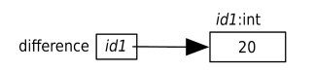
Memory Visualization Example
>>> difference = 20
>>> double = 2 * difference
>>> double
40
>>> difference = 5
>>> double
40
Evaluate the expression on the right of the = sign -> 20.
This produces the value 20, which we’ll put at memory address id1.
Make the variable on the left of the = sign, difference, refer to 20 by storing id1 in difference.

Slide 15
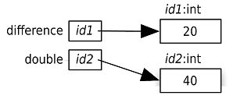
Memory Visualization Example
>>> difference = 20
>>> double = 2 * difference
>>> double
40
>>> difference = 5
>>> double
40
Evaluate the expression on the right of the = sign: 2 * difference. As we see in the memory model, difference refers to the value 20, so this expression is equivalent to 2 *20, which produces 40. We’ll pick the memory address id2 for the value 40.
Make the variable on the left of the = sign, double, refer to 40 by storing id2 in double.

Slide 16
Memory Visualization Example
>>> difference = 20
>>> double = 2 * difference
>>> double
40
>>> difference = 5
>>> double
40
When Python executes the third statement, double, it merely looks up the value that double refers to (40) and displays it.

Slide 17
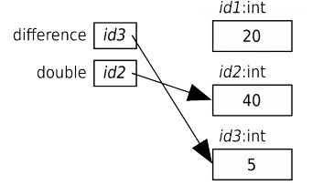
Memory Visualization Example
>>> difference = 20
>>> double = 2 * difference
>>> double
40
>>> difference = 5
>>> double
40
Evaluate the expression on the right of the = sign: 5. This produces the value 5, which we’ll put at the memory address id3.
Make the variable on the left of the = sign, difference, refer to 5 by storing id3 in difference.

Slide 18
Memory Visualization Example
>>> difference = 20
>>> double = 2 * difference
>>> double
40
>>> difference = 5
>>> double
40
Variable double still contains id2, so it still refers to 40. Neither variable refers to 20 anymore which is OK as Python will take care of recycling of memory when it is no longer used.

Slide 19
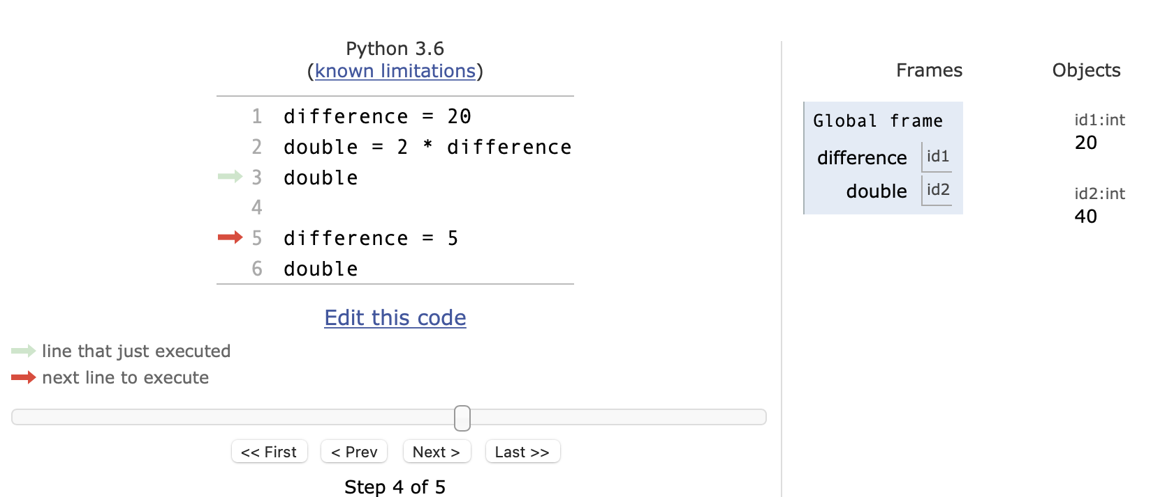
Python Tutor Visualization
http://pythontutor.com/visualize.html
Code might seem simple now…
Notes:
So there’s a website I’ll leave here for your reference, and I wouldn’t be leaving it if I didn’t think it was useful. I use this myself sometimes when I want to see what’s going on.
It allows you to go step by step through the code, while seeing where in memory each value is stored, and what variable name points to what area of memory.
Code might seem simple now, especially in this simple example, but when you get to your labs, especially the later ones, testing a block of code with this visualizer can really help you see where you’re going wrong.

Slide 20
Variables and Memory
Let’s go experiment with some of what we just saw
Assignment statements
Declaring variables
Different variable names
Memory locations
(and the famous print statement!)
Open your notebook
Click Link:
2. Variables and Memory

Slide 21
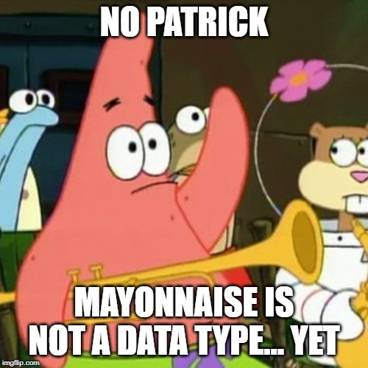
Variable Types
A type is a set of values and the operations that can be performed on those values.
int: integer
ex. 3, 4, 894, 0, -3, -18
float: floating point number
ex. -5.6, 7.342, 53452.0, -89.34

Slide 22
Numerical Type Examples
>>> 5 + 2 * 4
>>> 5.0 + 2 * 4
>>> 30/6
>>> 30//6

Slide 23
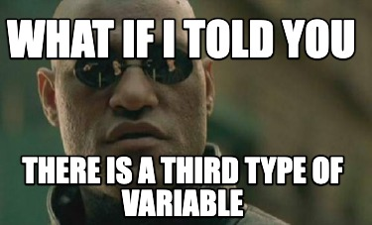
Type: str (pronounced string)
str: string literal is a sequence of characters
Start and end with single quotes (') or double quotes (")
ex. 'hello', "What is 10 * (2 + 9)?”
Just like writing in English, the quote type must match (i.e. 2 singles or 2 doubles, not 1 of each)

Slide 24
String Type Examples
>>> ‘how are you?’
>>> “short- and long-term”
>>> ‘“APS106” is already my favourite course’
>>> “APS106 stinks’
SyntaxError
Notes:
Single quote example
Double quotes
Using both together (paird properly) if you wanted to actually see quotation marks within your string
Example of what happens if you don’t pair up,

Slide 25
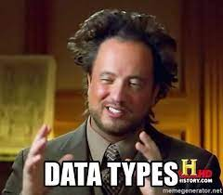
More data types?!
You can get the data type of any object by using the type() function
>>> x = 5
>>> print(type(x))
<class ‘int’>
Other Python data types:
List
Tuple
Dictionary
Set
Boolean
BUT we will worry about these later…
Notes:
Use the type() function if you ever want to see the type of a variable.
Just like how you use the print function, or the id function

Slide 26
Variables Types
Let’s go experiment with some of what we just saw
“int”s vs “float”s
The ”str” type
Using types and variables in expressions
Combining our type knowledge with some arithmetic operations
Open your notebook
Click Link:
3. Different Types of Variables

Slide 27
Augmented Assignment Operations
Operator | Expression | Identical Expression | English description
+= | x = 7 x += 2 | x = 7 x = x + 2 | x refers to 9
-= | x = 7 x -= 2 | x = 7 x = x - 2 | x refers to 5
*= | x = 7 x *= 2 | x = 7 x = x * 2 | x refers to 14
/= | x = 7 x /= 2 | x = 7 x = x / 2 | x refers to 3.5
//= | x = 7 x //= 2 | x = 7 x = x // 2 | x refers to 3
%= | x = 7 x %= 2 | x = 7 x = x % 2 | x refers to 1
**= | x = 7 x **= 2 | x = 7 x = x ** 2 | x refers to 49
Open your notebook
Click Link:
4. Augmented Assignment Operators

Slide 28
Let’s Code! Convert gas mileage from American to Canadian
In the old days (and still in the United States), the mileage of a gas-powered car was measured in miles per gallon.
Now for places that use the metric system, we prefer to measure “mileage” as “fuel consumption” in litres per hundred kilometres.
Write code to do the conversion to metric given a value in miles per gallon.
Open your notebook
Click Link:
5. Let’s Code!

Slide 29
Variables, Expressions and Operators.
Week 1 | Lecture 2 (1.2)

